Slide 1
R – Data Structures

Slide 2
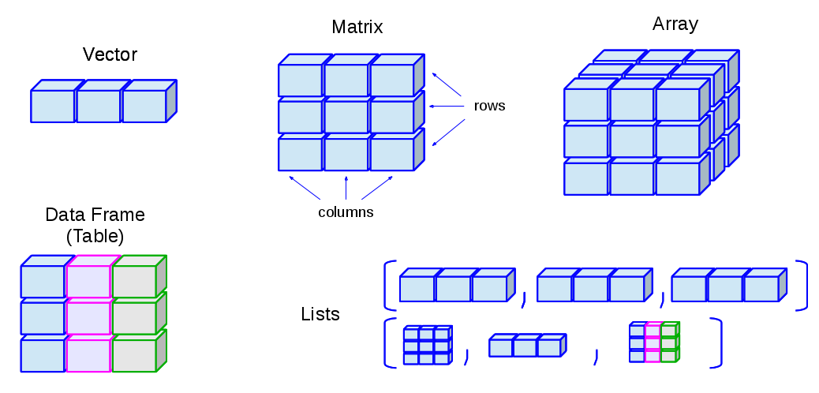
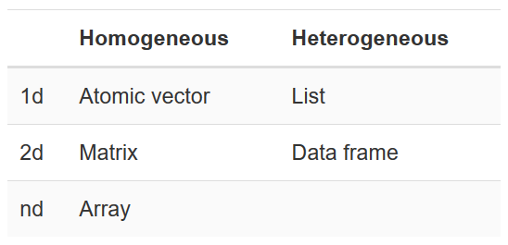
R – Data Structures

Slide 3
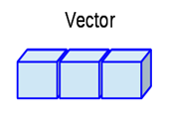
Vectors - Definition
Basic data structures in R programming.
Only contains elements of the same data type, so it is homogeneous
Data types can be numeric, integer, character, complex or logical.
The elements in the vector are components
Created using c() function
To check the type of vector by using typeof() function.

Slide 4
Types of Vectors
Atomic Vectors - all the elements are of the same data type
Lists - the elements are of different data types
Vector length
To find the number of elements in a vector by using length() function

Slide 5
Creating Vectors
1. Using c() function
This function returns a one-dimensional array or simply vector.
The c() function is a generic function which combines its argument.
All arguments are restricted with a common data type which is the type of the returned value.
> x <- c(1,2,3,4,5) #creates a vector named x
> x #prints the vector x

Slide 6
Creating Vectors
2. Using the colon(:) operator
Syntax
This operator creates a vector with elements from x to y and assigns it to z.
z = x : y

Slide 7
Creating Vectors
3. Using the seq() function
A sequence function creates a sequence of elements as a vector.
The seq() function is used in two ways, i.e., by setting step size with ’by' parameter or specifying the length of the vector with the 'length.out' feature.

Slide 8
Atomic Vectors
Four Types of Atomic Vectors
1. Numeric vector
The decimal values are called as numeric data types in R.
A vector which contains numeric elements is known as a numeric vector.

Slide 9
Atomic Vectors
2. Integer vector
A numeric value without a decimal point is known as integer data.
This integer data is represented by "Int."
The Int size is 2 bytes and long Int size of 4 bytes.
There is two way to assign an integer value to a variable, i.e., by using as.integer() function and appending of L to the value.
A vector which contains integer elements is known as an integer vector.

Slide 10
Atomic Vectors
3. Character vector
A character is held as a one-byte integer in memory.
In R, there are two different ways to create a character data type value
Using as.character() function and by typing string between double quotes("") or single quotes('')
A vector which contains character elements is known as character vector

Slide 11
Atomic Vectors
4. Logical Vector
The logical data types have only two values i.e., True or False.
These values are based on which condition is satisfied.
A vector which contains Boolean values is known as the logical vector.

Slide 12
Accessing Elements of Vectors
Elements of a vector is accessed with the help of vector indexing.
Indexing denotes the position where the value in a vector is stored.
Indexing will be performed with the help of integer, character, or logic.

Slide 13
Indexing with integer vector
In R, the indexing starts from 1, whereas in C, C++ and java the indexing starts from 0
Perform indexing by specifying an integer value in square braces [] next to our vector.
Example:
seq_vec<-seq(1,4,length.out=6)
seq_vec
seq_vec[2]
Output
[1] 1.0 1.6 2.2 2.8 3.4 4.0 [1] 1.6

Slide 14
2) Indexing with a character vector
In character vector indexing, we assign a unique key to each element of the vector.
These keys are uniquely defined as each element and can be accessed very easily.
Example:
char_vec<-c("Ram"=25,"Arun"=23,"Raja"=30)
char_vec
char_vec["Arun"]
Output
Ram Arun Raja 25 23 30 Arun 23

Slide 15
3) Indexing with a logical vector
In logical indexing, it returns the values of those positions whose corresponding position has a logical vector TRUE.
Example:
a<-c(1,2,3,4,5,6)
a[c(TRUE,FALSE,TRUE,TRUE,FALSE,TRUE)]
Output
[1] 1 3 4 6

Slide 16
Vector operations
1) Combining vectors
The c() function is not only used to create a vector, but also used to combine two vectors.
By combining one or more vectors, it forms a new vector which contains all the elements of each vector.
Example:
x<-c(1,2,3,4,5,6)
y<-c("aaa","bbb","ccc","ddd","eee","fff")
z<-c(x,y)

Slide 17
2) Arithmetic operations
We can perform all the arithmetic operation on vectors.
The arithmetic operations are performed member-by-member on vectors.
We can add, subtract, multiply, or divide two vectors.
Example:
a<-c(1,3,5,7)
b<-c(2,4,6,8)
a+b
a-b
a/b
a%%b

Slide 18
2a) Vector Element Recycling
If we apply arithmetic operations to two vectors of unequal length, then the elements of the shorter vector are recycled to complete the operations.
x=c(3,8,4,5,0,11)
y=c(4,11)
# y becomes c(4,11,4,11,4,11)
z=x+y
z
z=x-y
z
[1] 7 19 8 16 4 22
[1] -1 -3 0 -6 -4 0

Slide 19
2b) Vector Element Sorting
Elements in a vector can be sorted using the sort() function.
x=c(56,76,32,12,-6,98,-87,45)
y=sort(x)
y
[1] -87 -6 12 32 45 56 76 98
# Sort the elements in the reverse order.
y=sort(x,decreasing=TRUE)
y
[1] 98 76 56 45 32 12 -6 -87

Slide 20
3) Logical Index vector
With the help of the logical index vector in R, we can form a new vector from a given vector.
This vector has the same length as the original vector. The vector members are TRUE only when the corresponding members of the original vector are included in the slice; otherwise, it will be false.
Example
a<-c(“aaa",”bbb",”ccc",”ddd",”eee",”fff")
b<-c(TRUE,FALSE,TRUE,TRUE,FALSE,FALSE)
a[b]
[1] “aaa” “ccc" “ddd"

Slide 21
4) Duplicate Index
An index vector allows duplicate values which means we can access one element twice in one operation.
Example:
q<-c(“aaa",”bbb",”ccc",”ddd",”eee",”fff")
q[c(2,4,4,3)]
[1] "bbb" "ddd" "ddd" "ccc"

Slide 22
5) Range Indexes
Range index is used to slice a vector to form a new vector.
For slicing, we used colon(:) operator.
Range indexes are very helpful for the situation involving a large operator.
Example:
q<-c(“aaa",“bbb",“ccc",“ddd",“eee",“fff")
b<-q[2:5]
b
[1] “bbb“ “ccc“ “ddd“ “eee"

Slide 23
6) Out-of-order Indexes
In R, the index vector can be out-of-order.
Below is an example in which a vector slice with the order of first and second values reversed.
Example:
q<-c(“aaa",”bbb",”ccc",”ddd",”eee",”fff")
q[c(2,1,3,4,5,6)]
[1] "bbb" "aaa" "ccc" "ddd" "eee" "fff"

Slide 24
7) Named vectors members
First create vector of characters as:
z=c(“R”, “Programming)
z
Then, name the first vector member as “First” and the second member as “Second”.
names(v) = c("First", "Second")
v
To retrieve the first member by its name as follows:
v["First"]
Also reverse the order using the character string index vector:
v[c("Second", "First")]

Slide 25
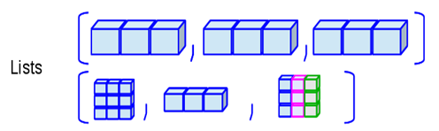
Lists Definition
In R, lists are the second type of vector.
Lists are the objects of R
Contain elements of different types such as number, vectors, string and another list inside it.
It can also contain a function or a matrix as its elements.
A list is a data structure which has components of mixed data types.
List is a generic vector which contains other objects.

Slide 26
List Creation
In R, the vector is created with the help of c() function.
Like c() function, there is another function, i.e., list() is used to create a list in R.
Syntax
list()
List can be created with same data type or with
different data type

Slide 27
Naming List elements
R provides a very easy way for accessing elements, i.e., by giving the name to each element of a list.
By assigning names to the elements, we can access the element easily.
There are only three steps to print the list data corresponding to the name:
1. Creating a list.
2. Assign a name to the list elements with the help of names() function.
3. Print the list data.

Slide 28
Naming List elements
# Creating a list containing a vector, a matrix and a list.
list_data<- list(c("Rama","Arun","Sita"), matrix(c(40,80,60,70,90,80), nrow = 2), list("BCA","MCA","B.tech"))
# Giving names to the elements in the list.
names(list_data) <- c("Students", "Marks", "Course")
# Show the list.
print(list_data)

Slide 29
Accessing List Elements
Two ways, we can access the elements of a list.
First one is the indexing method performed in the same way as a vector.
In the second one, we can access the elements of a list with the help of names.
It will be possible only with the named list.; we cannot access the elements of a list using names if the list is normal.
By using index
By using names

Slide 30
Manipulation of list elements
R allows us to add, delete, or update elements in the list.
We can update an element of a list from anywhere, but elements can add or delete only at the end of the list.
To remove an element from a specified index, we will assign it a null value.
We can update the element of a list by overriding it from the new value.

Slide 31
Converting list to vector
Cannot perform all the arithmetic operations on list elements. This is a drawback of using list
To remove this drawback, R provides unlist() function.
This function converts the list into vectors.
In some cases, it is required to convert a list into a vector so that we can use the elements of the vector for further manipulation.
The unlist() function takes the list as a parameter and change into a vector.

Slide 32
Merging Lists
R allows us to merge one or more lists into one list.
Merging is done with the help of the list() function also.
To merge the lists, we have to pass all the lists into list function as a parameter, and it returns a list which contains all the elements which are present in the lists.
Example
# Creating two lists.
Even_list <- list(2,4,6,8,10)
Odd_list <- list(1,3,5,7,9)
# Merging the two lists.
merged.list <- list(Even_list,Odd_list)
# Printing the merged list.
print(merged.list)

Slide 33
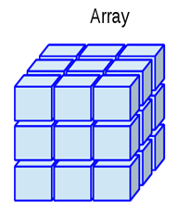
Arrays - Definition
R arrays are data objects that store data in more than two dimensions.
Homogeneous in nature. They can store values of a single basic data type only.
They store the data in the form of layered matrices.
An array is created with the help of the array() function.
This array() function takes a vector as an input and to create an array it uses vectors values in the dim parameter.
For example- if we will create an array of dimension (2, 3, 4) then it will create 4 rectangular matrices of 2 row and 3 columns.

Slide 34
R Array Syntax
array_name <- array(data, dim= (row_size, column_size, matrices, dim_names))
data
The data is the first argument in the array() function. It is an input vector which is given to the array.
matrices
In R, the array consists of multi-dimensional matrices.
row_size
This parameter defines the number of row elements which an array can store.
column_size
This parameter defines the number of columns elements which an array can store.
dim_names
This parameter is used to change the default names of rows and columns.

Slide 35
Array Creation
Arrays are created using vector and array() function.
In array, data is stored in the form of the matrix.
Two steps to create a matrix
In the first step, we will create two vectors of different lengths.
Once our vectors are created, we take these vectors as inputs to the array.
# Create two vectors of different lengths.
vector1=c(10,20,30)
vector2=c(5,6,7,8,9,10)
# Take these vectors as input to the array.
result <- array(c(vector1,vector2),dim = c(3,3,2))
print(result)

Slide 36
Naming Columns and Rows
In R, we can give the names to the rows, columns, and matrices of the array.
This is done with the help of the dim name parameter of the array() function.
It is not necessary to give the name to the rows and columns.
It is only used to differentiate the row and column for better understanding.

Slide 37
Accessing Array elements
Like C or C++, we can access the elements of the array.
The elements are accessed with the help of the index.
Simply, we can access the elements of the array with the help of the indexing method.

Slide 38
Manipulating Array Elements
The array is made up matrices in multiple dimensions so that the operations on elements of an array are carried out by accessing elements of the matrices.

Slide 39
Calculations across Array elements
For calculation purpose, r provides apply() function.
This apply function contains three parameters i.e., x, margin, and function.
This function takes the array on which we have to perform the calculations.
Syntax
apply(x, margin, fun)
Here, x is an array, and a margin is the name of the dataset which is used and fun is the function which is to be applied to the elements of the array.

Slide 40
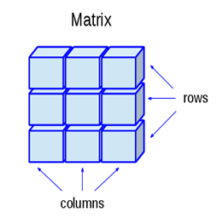
Matrix - Definition
In R, a two-dimensional rectangular data set is known as a matrix.
A matrix is created with the help of the vector input to the matrix function.
On R matrices, we can perform addition, subtraction, multiplication, and division operation.
In the R matrix, elements are arranged in a fixed number of rows and columns.
The matrix elements are the real numbers. In R, we use matrix function, which can easily reproduce the memory representation of the matrix.
In the R matrix, all the elements must share a common basic type.

Slide 41
A Matrix is created using the matrix() function
Syntax
matrix(data, nrow, ncol, byrow, dimnames)
data is the input vector which becomes the data elements of the matrix.
nrow is the number of rows to be created.
ncol is the number of columns to be created.
byrow is a logical clue. If TRUE then the input vector elements are arranged by row.
dimname is the names assigned to the rows and columns.

Slide 42
Matrix Creation
Like vector and list, R provides the matrix() function to create a matrix.
This function plays an important role in data analysis.
Example
#Arranging elements sequentially by row.
P <- matrix(c(5:16), nrow = 4, byrow = TRUE)
print(P)
# Arranging elements sequentially by column.
Q <- matrix(c(3:14), nrow = 4, byrow = FALSE)
print(Q)

Slide 43
Accessing Matrix Elements in R
Three ways to access the elements from the matrix.
1. Access the element which presents on nth row and mth column.
2. Access all the elements of the matrix which are present on the nth row.
3. Access all the elements of the matrix which are present on the mth column.

Slide 44
Matrix Operations
Matrix Addition
Matrix Subtraction
Matrix Multiplication
Multiplication by Constant
Matrix Division

Slide 45
Factors
Factors are the data objects which are used to categorize the data and store it as levels.
They can store both strings and integers.
They are useful in the columns which have a limited number of unique values.
Like "Male, "Female" and True, False etc. They are useful in data analysis for statistical modeling.
Factors are created using the factor() function by taking a vector as input.

Slide 46
Attributes of a factor
X It is the input vector which is to be transformed into a factor.
levels It is an input vector that represents a set of unique values which are taken by x.
labels It is a character vector which corresponds to the number of labels.
Exclude It is used to specify the value which we want to be excluded,
ordered It is a logical attribute which determines if the levels are ordered.
nmax It is used to specify the upper bound for the maximum number of level.

Slide 47
How to create a factor?
A factor is created in two steps
In the first step, we create a vector.
Next step is to convert the vector into a factor
R provides factor() function to convert the vector into factor.
Syntax of factor function
factor_data<- factor(vector)

Slide 48
Accessing components of factor
The process of accessing components of factor is much more similar to the vectors.
We can access the element with the help of the indexing method or using logical vectors.
# Creating a vector as input.
data <- c("aaa","bbb","ccc","bbb","aaa","ddd","bbb","aaa","ddd","ccc","ddd")
# Applying the factor function.
factor_data<- factor(data)
#Printing all elements of factor
print(factor_data)
#Accessing 4th element of factor
print(factor_data[4])
#Accessing 5th and 7th element
print(factor_data[c(5,7)])
#Accessing all element except 4th one
print(factor_data[-4])
#Accessing elements using logical vector
print(factor_data[c(TRUE,FALSE,FALSE,FALSE,TRUE,TRUE,TRUE,FALSE,FALSE,FALSE,TRUE)])

Slide 49
Changing the Order of Levels
The order of the levels in a factor can be changed by applying the factor function again with new order of the levels.
data <- c("East","West","East","North","North","East","West",
"West","West","East","North")
# Create the factors
factor_data <- factor(data)
print(factor_data)
# Apply the factor function with required order of the level.
new_order_data <- factor(factor_data,levels = c("East","West","North"))
print(new_order_data)

Slide 50
Generating Factor Levels
Generate factor levels by using the gl() function.
It takes two integers as input which indicates how many levels and how many times each level.
Syntax
gl(n, k, labels)
n is a integer giving the number of levels.
k is a integer giving the number of replications.
labels is a vector of labels for the resulting factor levels.

Slide 51
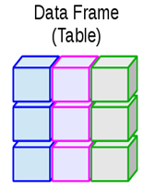
Data Frames
A data frame is a two-dimensional array-like structure or a table in which a column contains values of one variable, and rows contains one set of values from each column.
A data frame is a special case of the list in which each component has equal length.
A data frame is used to store data table and the vectors which are present in the form of a list in a data frame, are of equal length.
In a simple way, it is a list of equal length vectors.
A matrix can contain one type of data, but a data frame can contain different data types such as numeric, character, factor, etc.

Slide 52
Data Frames
Characteristics of a data frame
The columns name should be non-empty.
The rows name should be unique.
The data which is stored in a data frame can be a factor, numeric, or character type.
Each column contains the same number of data items.

Slide 53
How to create Data Frame?
In R, the data frames are created with the help of frame() function of data.
This function contains the vectors of any type such as numeric, character, or integer.
Example, we create a data frame that contains employee id (integer vector), employee name(character vector), salary(numeric vector), and starting date(Date vector).

Slide 54
Getting the structure of R Data Frame
In R, we can find the structure of our data frame.
R provides an built-in function called str() which returns the data with its complete structure.
Example, we have created a frame using a vector of different data type and extracted the structure of it.

Slide 55
Summary of data in Data Frames
In some cases, it is required to find the statistical summary and nature of the data in the data frame.
R provides the summary() function to extract the statistical summary and nature of the data.
This function takes the data frame as a parameter and returns the statistical information of the data.

Slide 56
Extracting data from Data Frame
The data in the data frame is very essential for us.
To manipulate the data in the data frame, it is essential to extract it from the data frame.
Extract the data in three ways:
Extract the specific columns from a data frame using the column name.
Extract the specific rows from a data frame.
Extract the specific rows corresponding to specific columns.

Slide 57
Modification in Data Frame
R allows us to do modification in our data frame.
Like matrices modification, we can modify our data frame through re-assignment.
We cannot only add rows and columns, but also we can delete them. The data frame is expanded by adding rows and columns.
Add a column by adding a column vector with the help of a new column name using cbind() function.
Add rows by adding new rows in the same structure as the existing data frame and using rbind() function
Delete the columns by assigning a NULL value to them.
Delete the rows by re-assignment to them.

